Slide 1
Local Adaptation in Olympia Oysters: HSP70 mRNA Expression Response to Mild Heat Stress

Slide 2
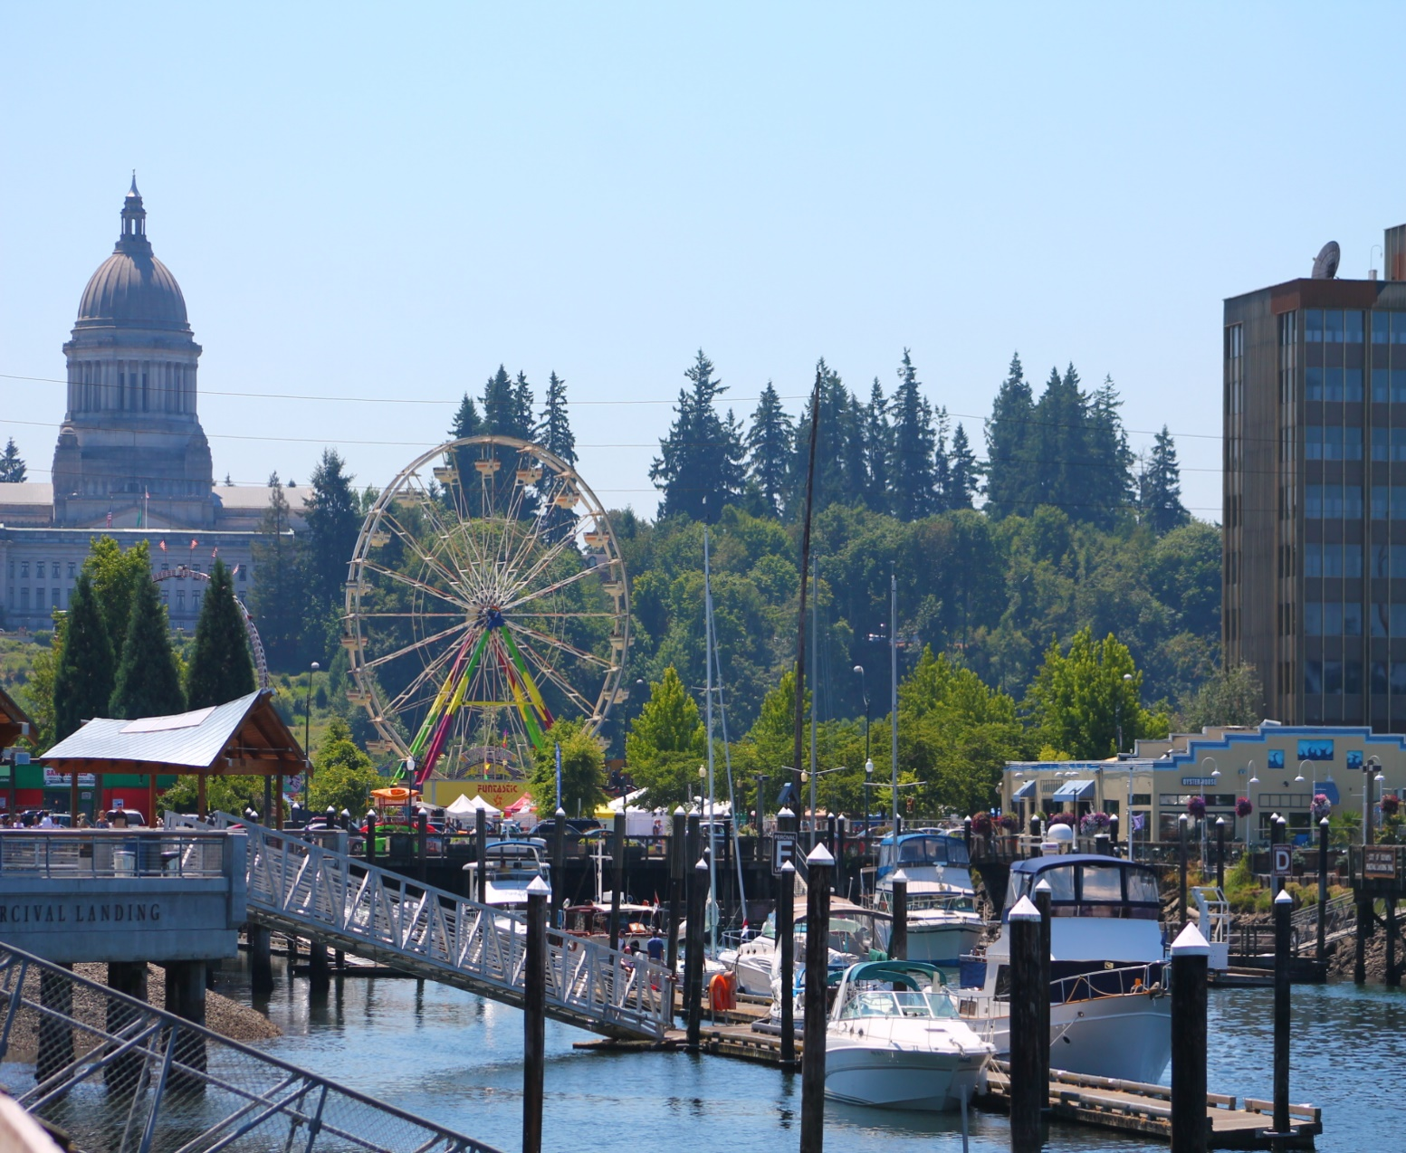
Olympia oysters in the Puget Sound
100 years of Anthropogenic Influence
Declines in most native species
Olympia oyster
Historically Important
Culturally Important
Commercially Harvest
Population Decline
Photo: thurstontalk.com

Slide 3
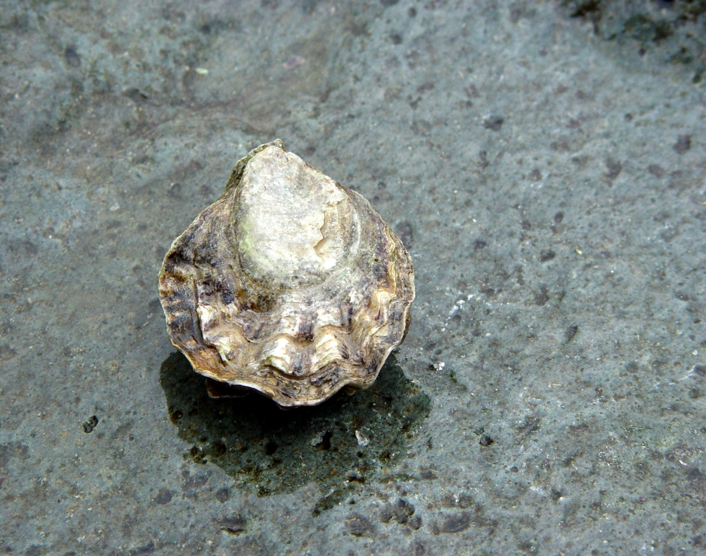
Life history of Olympia Oysters
Mexico to Alaska
Cold Water Adapted
Small Size
Salinity requirements
Threatened By
Pollution
Fresh Water Inundation
Overharvest
Ocean Acidification
Climate Change
Photo: John Rowley/ Flickr

Slide 4
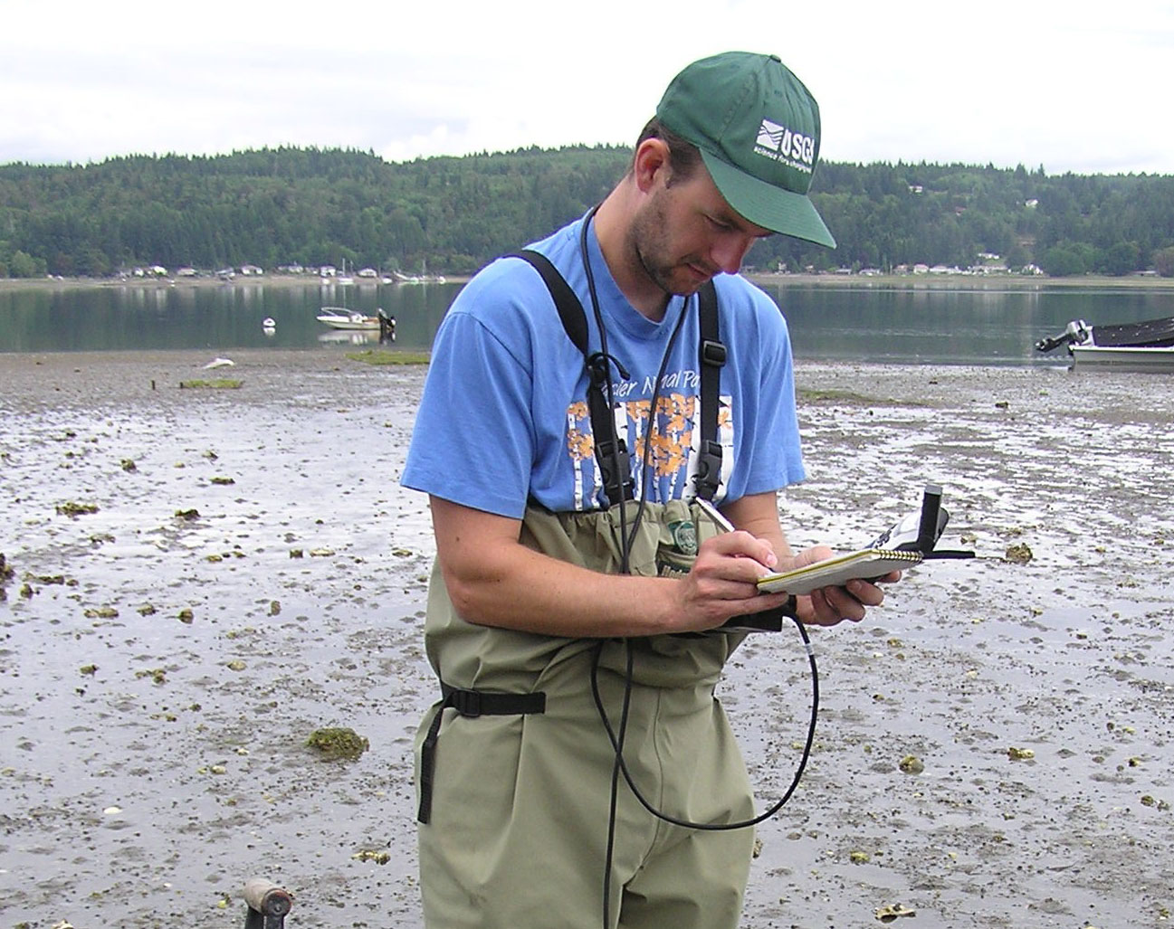
Rehabilitation Efforts
Extensive Rehabilitation Efforts
Puget Sound Restoration Fund
NOAA/NMFS
Private Producers
Limited Success
Poor Location Selection
Poor outplanting timing
High Predation
Other?
Photo: Puget Sound Restoration Fund

Slide 5
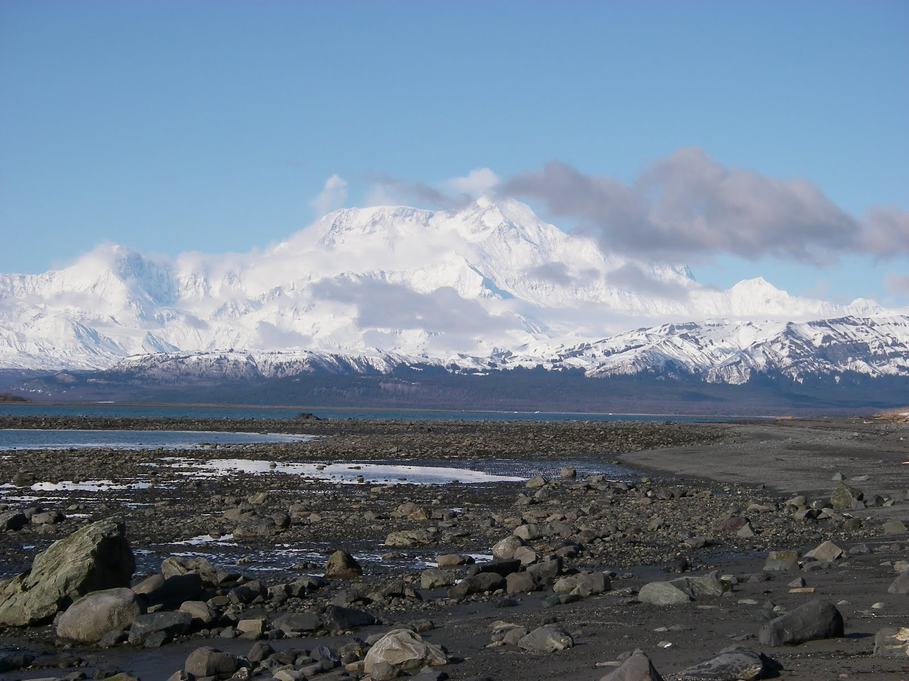
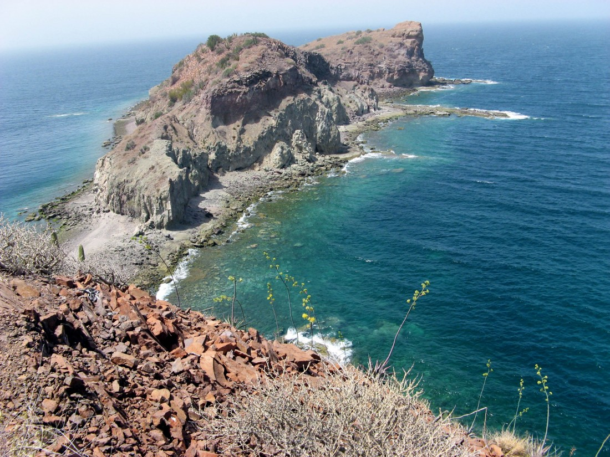
Local Adapation
Local adaptation is a phenomena in which geographically separated populations of a native species are better adapted to the habitat parameters of their specific location.(Kawecki and Ebert, 2004).
Photo: Baja Travel Tours
Photo: Alaskan Cruises

Slide 6
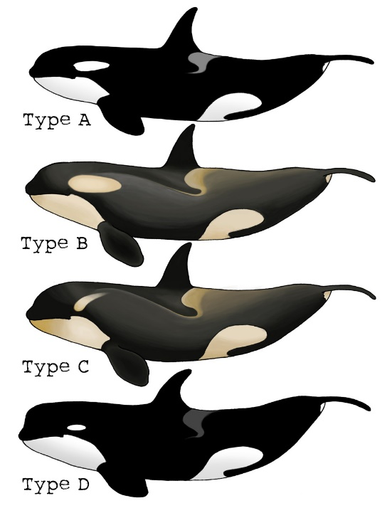
Local Adaptation Cont.
Differing Environment Conditions and Selection
Temperature
Salinity
DO
Etc.
Genetic and Phenotypic Differences
Size, Shape, Color, Etc
Growth/Development
Response Mechanisms
Photo: retrieverman.net

Slide 7
Response Mechanisms
Many pathways effected
Energy Metabolism
Reproduction
Homeostatic Regulatory Enzymes
Affected Regulatory Enzymes
Copper Toxicity Response (Ritter et al., 2010)
Phosphoglucose isomerase (Dahlhoff and Rank, 2000)
HSP70 (Feder and Hofmann, 1999)
Effects
Downregulation
Isoform Concentrations
Priming

Slide 8
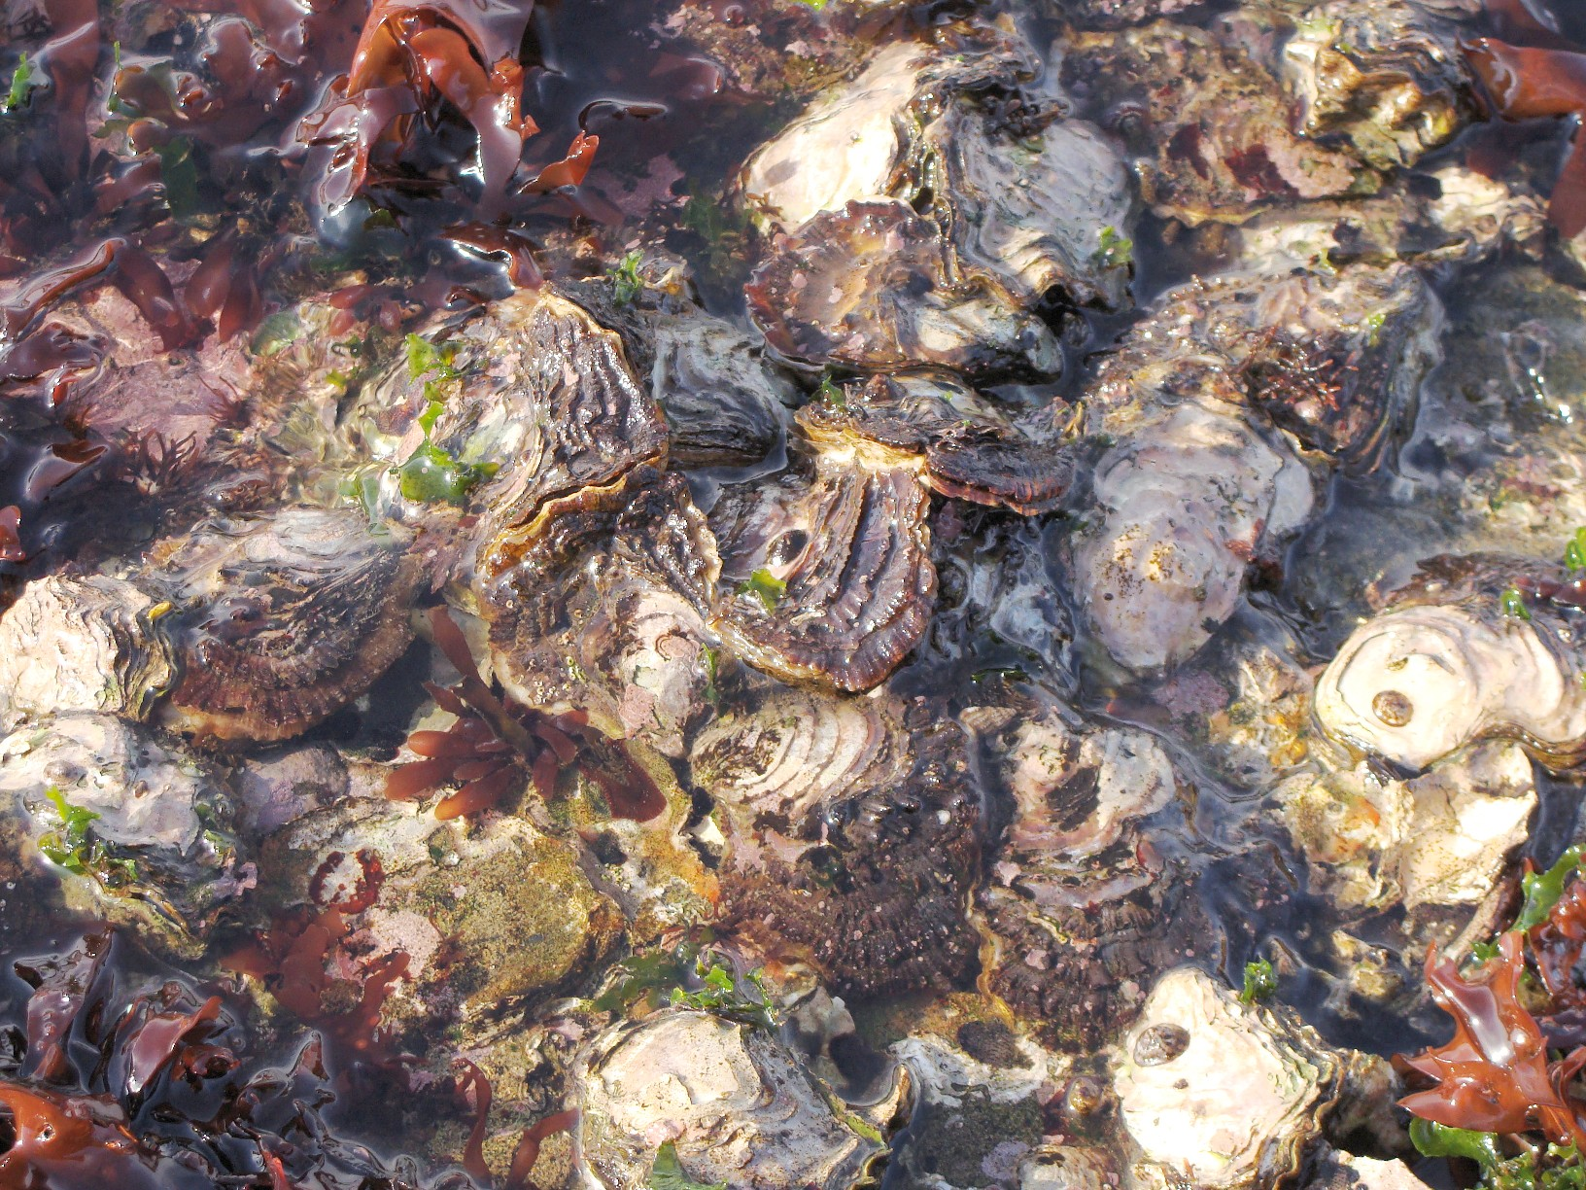
HSP70
Maintain Protein Function
Biomarker for Stress
Affected by Local Adaptation
Well Studied
Photo: Matt DiLeo/thescientistgardner blog

Slide 9
Hypothesis
Populations from warmer southern regions will be better adapted to handle heat stress than those from colder northern regions.
Does HSP70 response vary between populations during mild heat stress events?
Can we measure this response through mRNA concentrations for HSP70 transcripts?

Slide 10
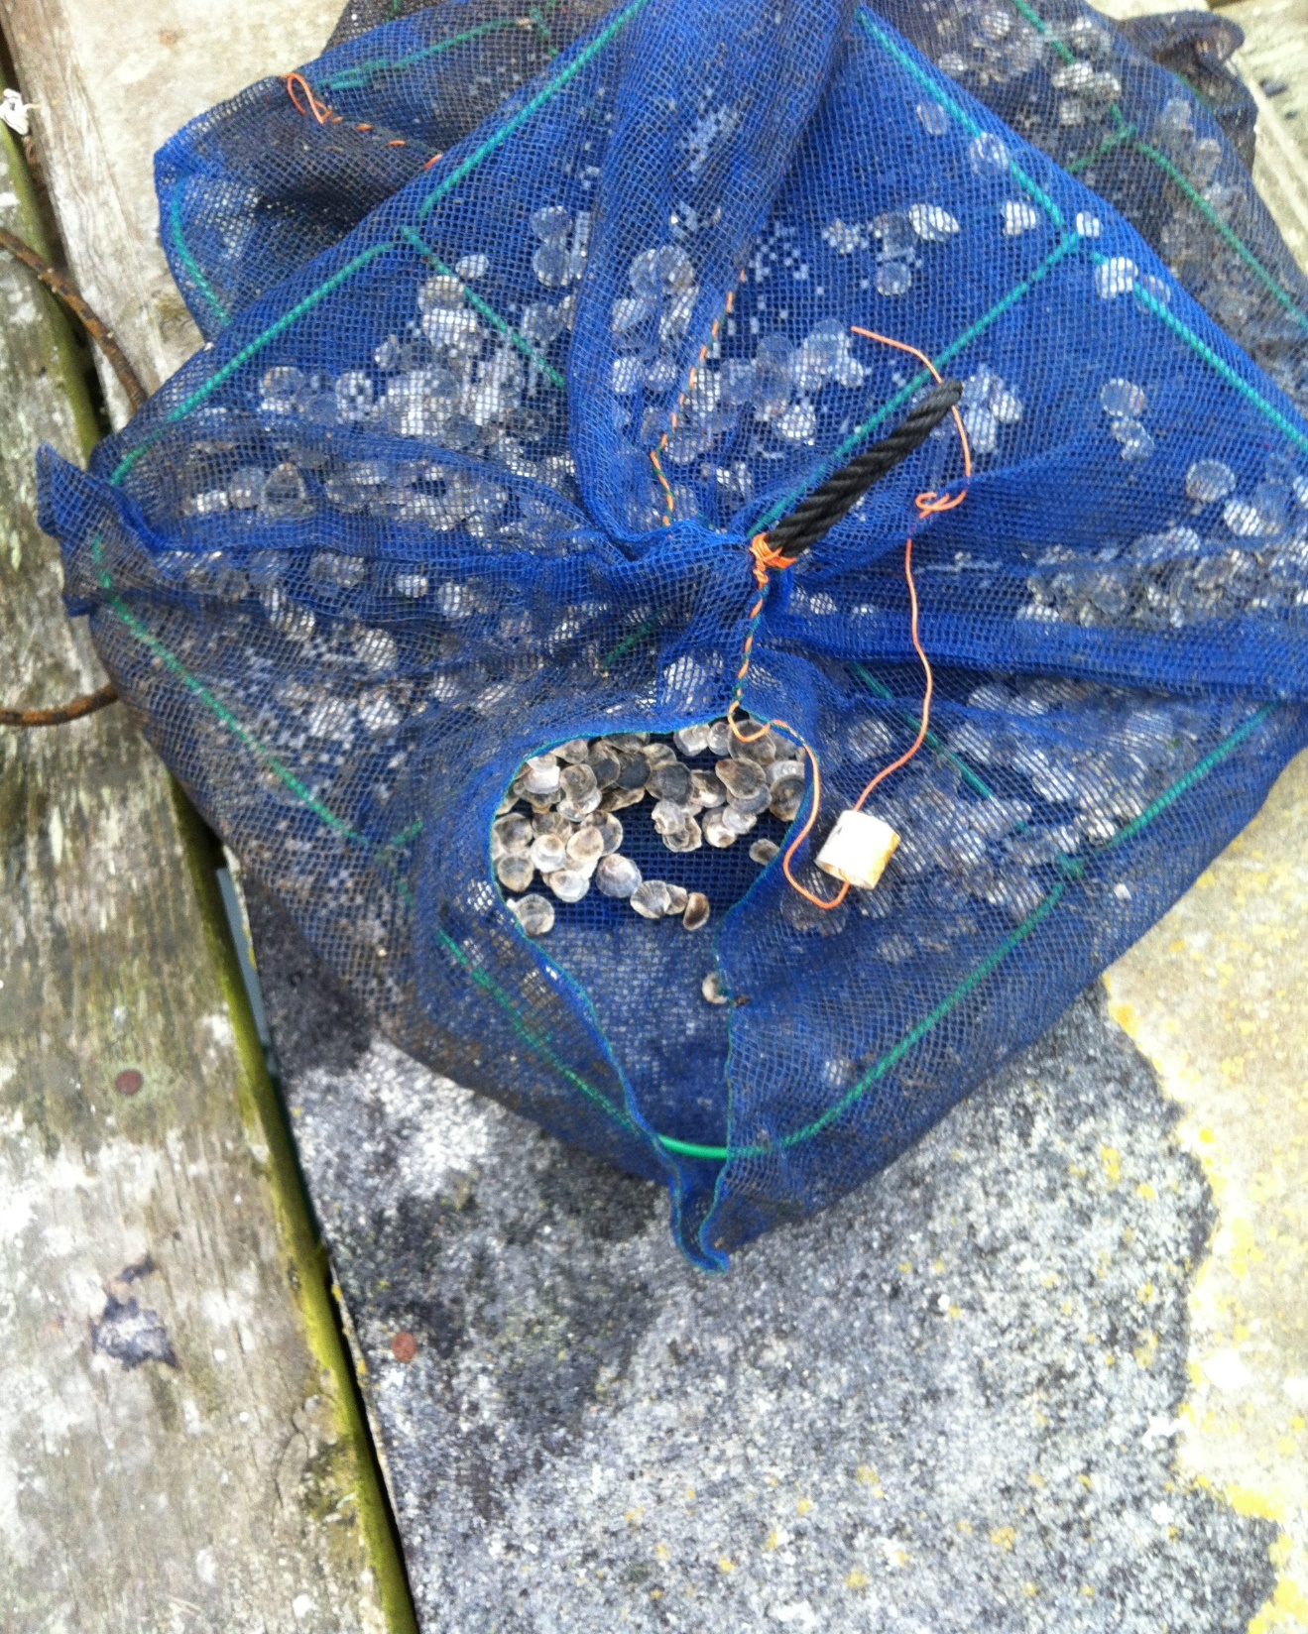
Experiment
Oysters
Offspring from 3 distinct populations
Collected in Port Gamble, WA
Set up
1 tank
Cold Room at 12 C
Acclimated 1 week
Fed once every 24 hours
Experiment
Time 0 (12 C)
Time 24 (24 C)
Fed once
Sampling
Measured Length
Dissected out 50-250 ug whole body tissue
Flash Frozen
Stored in TriReagent
Photo: Christine Savolainen

Slide 11
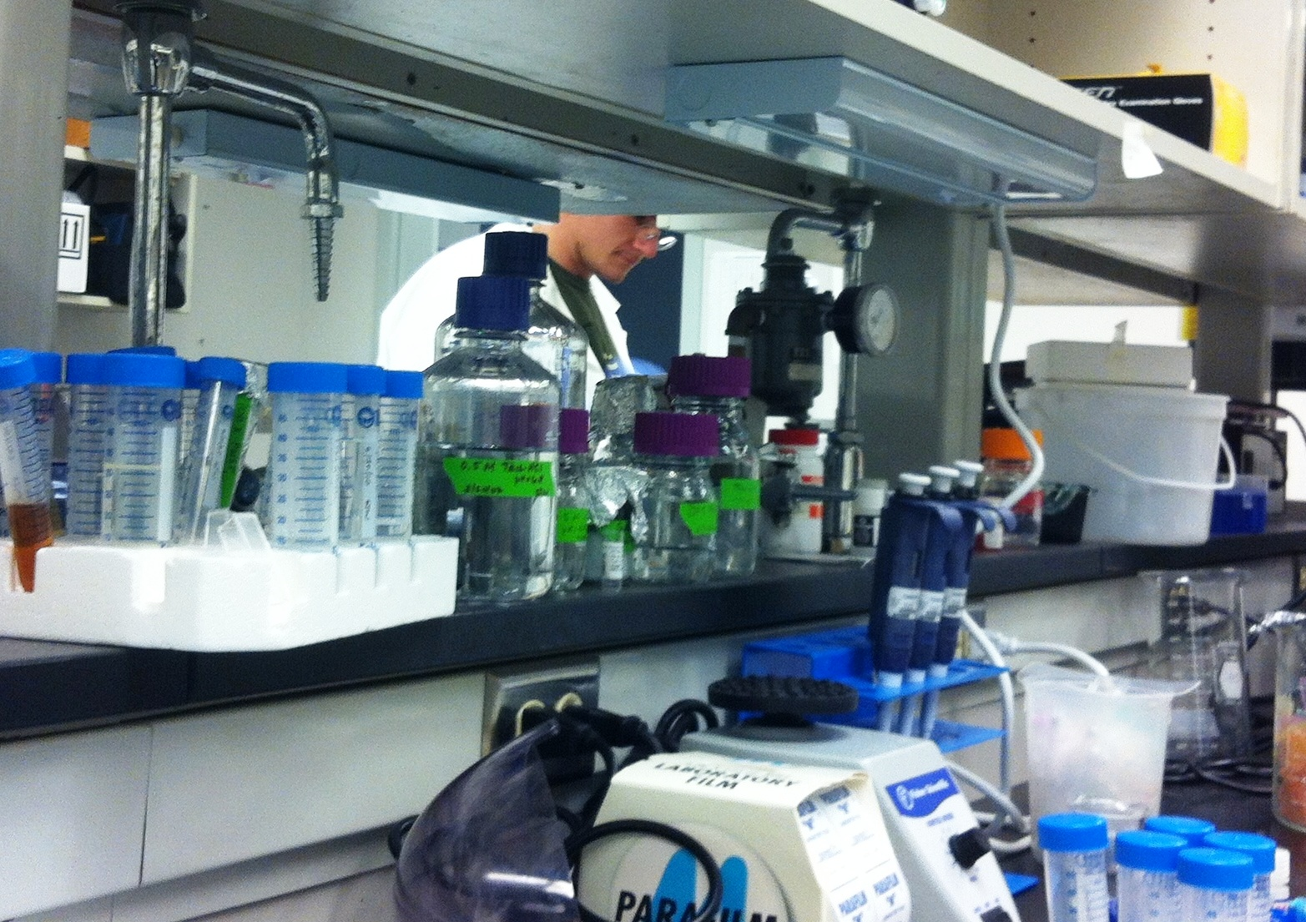
Processing/Testing
Phenol/Chloroform RNA isolation
cDNA created
Primers Designed
HSP70 (C. gigas)
Actin (O. lurida, Normalizing)
PCR
qPCR
Photo: Christine Savolainen

Slide 12
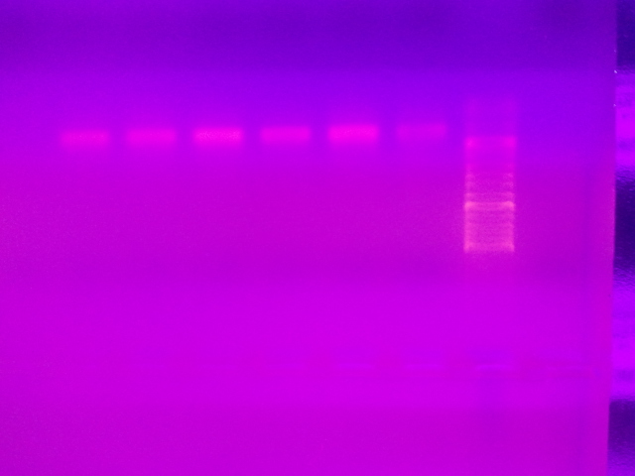
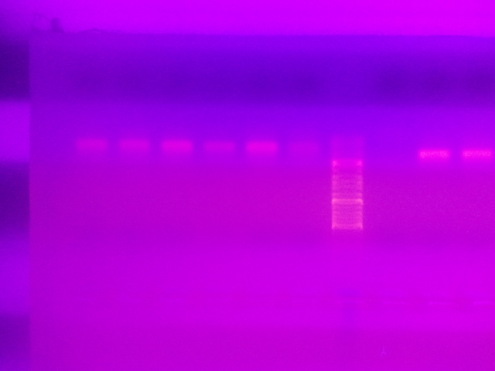
Results—PCR
Products in Agarose Gels
Strong Banding
Low Base pair sizes
In both HSP70 and Actin

Slide 13
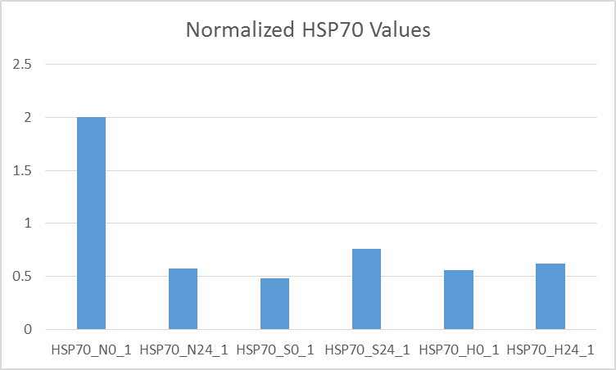
Results—qPCR
Fluoresence Measured In Samples not Control
C(t) between 26-30
Later than expected
C(t) converted and normalized
=10^(-(0.3012*Ct)+11.434)
Normalized =V(h)/V(a)

Slide 14
Discussion
PCR results mediocre
Bands too small to be significant
Non specific to target
qPCR results mirror PCR
Amplification late in cycles
Indiscriminate replication leading
No Valuable Insights from Data
Photo: Charlie Day/Pacific Rim/ Legendary Pictures

Slide 15
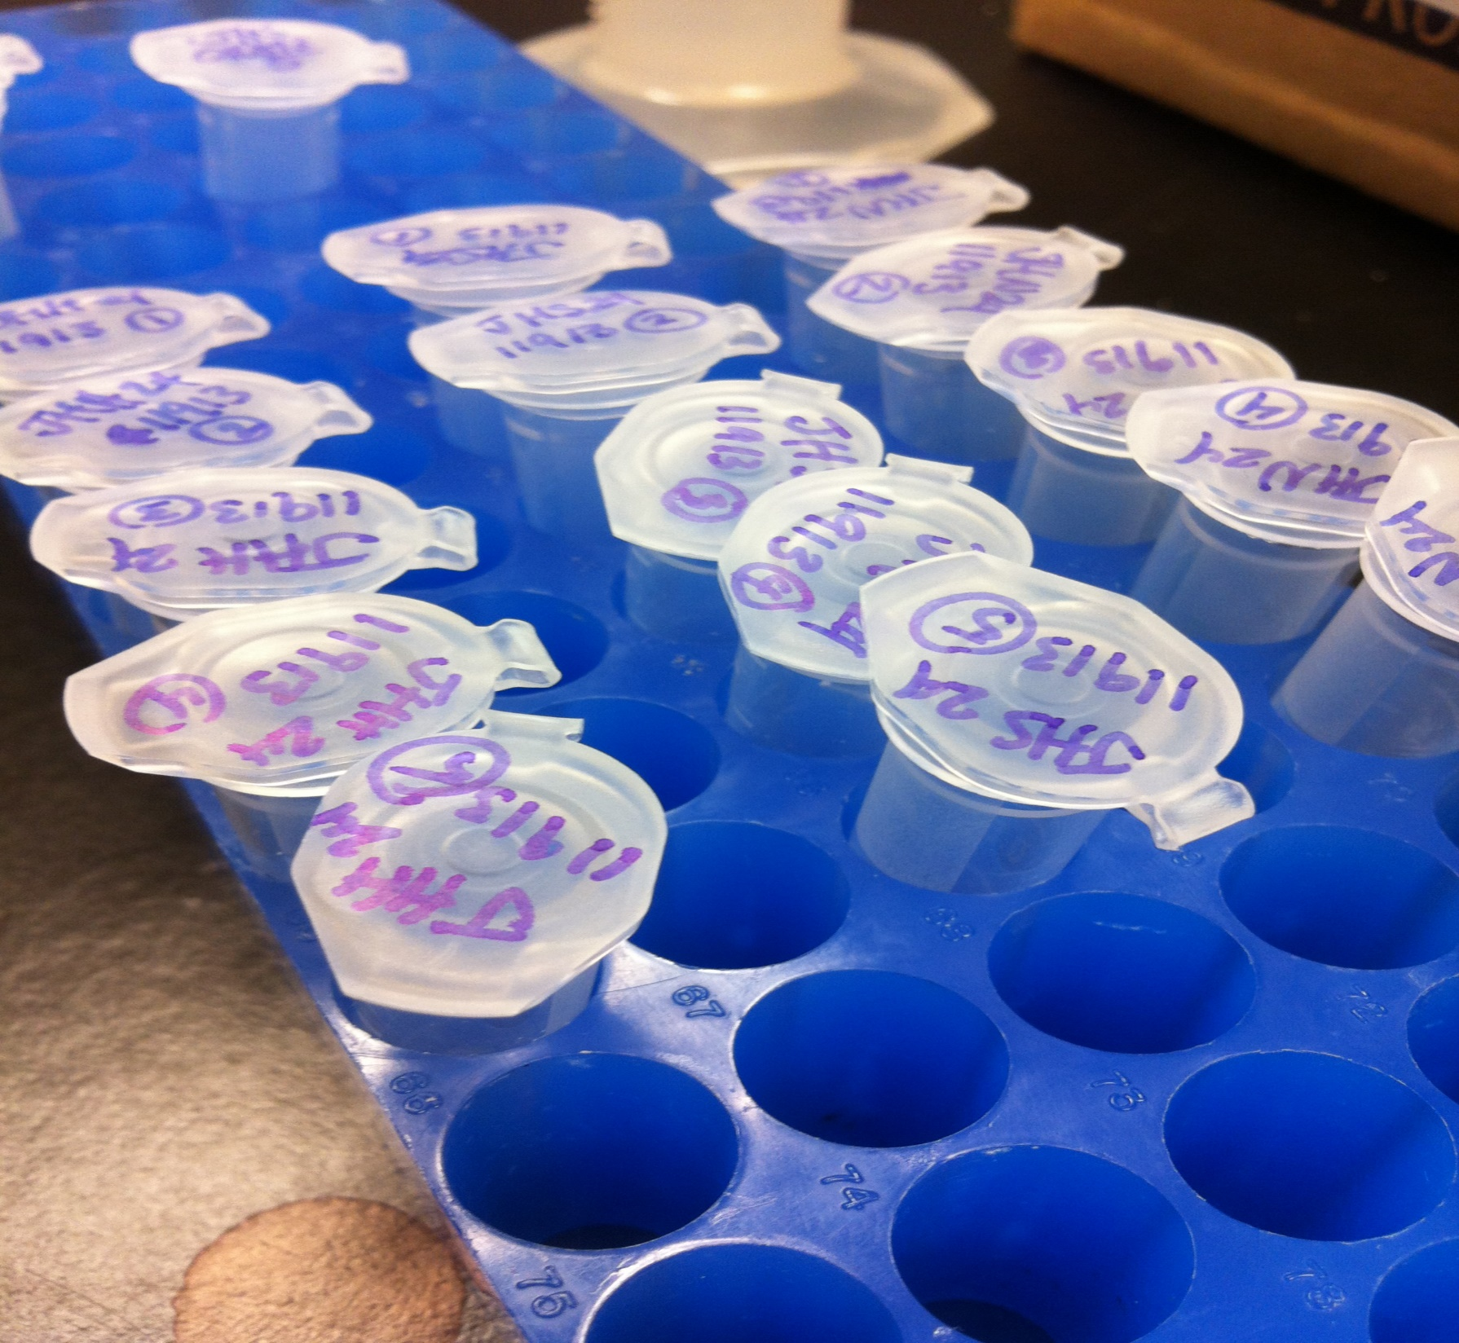
Conclusion
Better Primers
More Intense Temperature Increase
More Time Points
Varied primers
Photo: Christine Savolainen

Slide 16
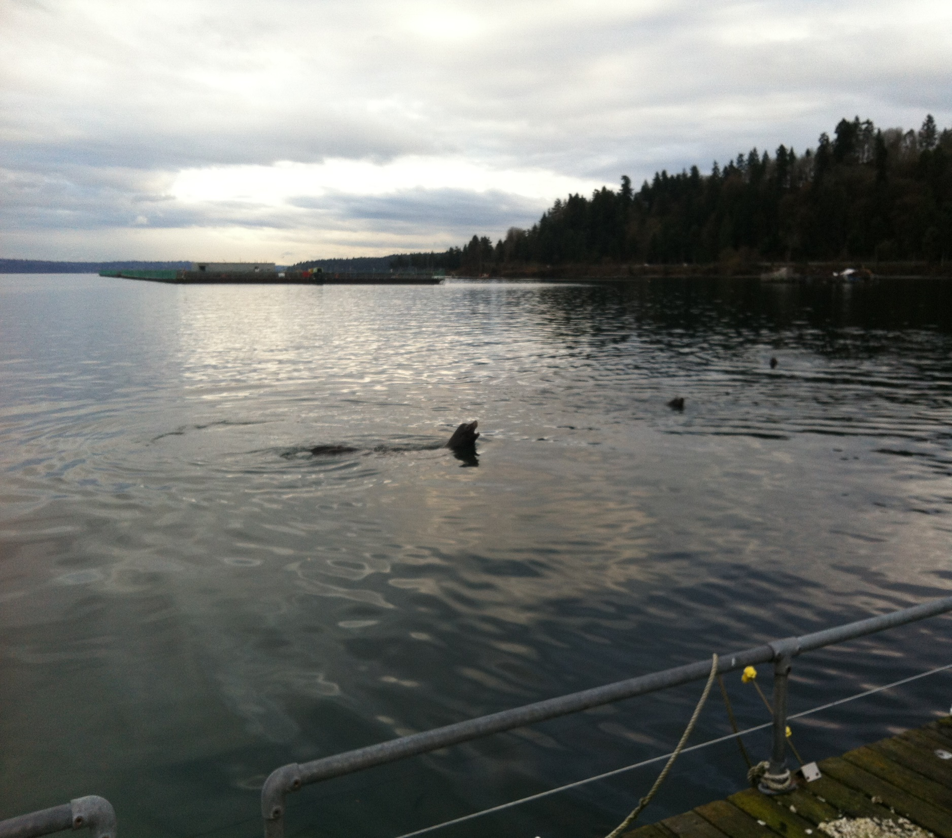
Thanks
Steven Roberts
Claire Olson
Mackenzie Gavery
Sam White
Ryan Crim PSRF
Christine Savolainen
And Viewers Like You!
Photo: Christine Savolainen

